Slide 1
Fee matching: from an APM draft to a feature engineering can build
PRODUCT MANAGER ASSIGNMENT · INTELLIPAAT
PROBLEM
SOLUTION
CONTROL PRINCIPLE
Parents and friends pay, one transfer covers two students, and screenshots stand in for bank proof. Money sits unmatched and receipts go wrong.
Automate only certain matches. Route the rest to evidence-based review, approved by a second person, posted once, receipted once.
Verified, matched, allocated, posted and receipted are five separate states. A name or a screenshot never proves money arrived.
Yasin Jariwala · AVP – Product Management · 27 October 2026 · with a working C# prototype
Notes:
Open with the one-line thesis: the draft treated "we matched a name" or "a student uploaded a screenshot" as "the fee is paid". Everything in this deck follows from separating five states. Mention up front that the logic is not only on slides: there is a working prototype and a C# application with server-side permissions, and every one of the nine sample payments runs through it. Likely question: why not just trust UPI screenshots to speed things up? Answer: a screenshot can show a failed, pending or edited payment; it is kept as evidence and linked automatically when the bank line arrives, so it speeds investigation without ever moving a balance.

Slide 2
The APM draft would post money it has not seen
GAP ANALYSIS
Business rules
User journeys
Technical and integration
No definition of verified money
Name fallback treated as a match
No fee-component or split rule
No Finance or Admin journey
No student dispute or receipt path
Bank feed and write-back unspecified
No duplicate or retry protection
Financial control
Exception handling
Usability and reporting
Counsellors edit payments, unchecked
Cash paid on counsellor’s word
Receipt issued at match time
Reversals and refunds missing
Payment before registration
Partial and overpayments
Dashboard cannot run operations
“Eliminate reconciliation in two weeks” has no baseline or estimate
11 of 15 block engineering start
Blockers: verification, matching precedence, fee components, splits, Finance roles, data source, idempotency, edits, cash, receipts, reversals.
2 · Full table of 15 gaps with corrections in the prototype (Gap analysis page)
Notes:
Six categories as the brief asked; 15 gaps in total, 11 must close before engineering starts because they change the data model, the integration contract or the financial controls. The four that can wait (student dispute path, payment before registration, dashboard reporting, the timeline claim) are needed before UAT, not before build. Lead with the two that would cost money: name fallback (R Mehta in P2 would be auto-assigned to Rohan) and receipt at match time (receipts for unverified, duplicate or wrong money). Likely question: which single gap is most dangerous? Answer: treating a screenshot or name as proof, because it moves balances and issues receipts with no money behind them.

Slide 3
Automate the certain, route the rest to evidence
PRODUCT SOLUTION AND MVP
User | Needs to
Student | See what is recognised, report a payment, get a valid receipt
Operations | Find the student behind each payment, with the evidence
Counsellor | Report cash with receipt-book and deposit proof
Finance | Import the bank feed, approve, apply reversals, verify cash
Admin | Manage roles and policy; never move money
Automatic
Import · duplicate block · match on a valid student ID · split parsing · idempotent posting · receipts
A person decides
Fee component · name or phone matches · cash · reversals · corrections · every approval, by someone other than the proposer
Not in the MVP
Refund payouts · a new payment gateway · replacing the student system · a two-week promise
3 · Dependencies: trusted bank feed format, student-system posting contract, Finance sign-off on policy
Notes:
The scope line I would defend: automation only where the outcome is deterministic and reversible by audit trail. Fee component allocation stays human until Finance approves an order (AA-1); it is a switch, not code. The MVP keeps the student-management system as master for students and balances; this tool owns the reconciliation workflow and writes postings to it. Likely question: will this really cut manual work? Answer: P1 and P3 (explicit ID) and P4 (duplicate) need no investigation at all; the queue gives the rest evidence and an owner. I would baseline last month's unmatched count before promising a percentage.

Slide 4
Every payment passes five gates, each with an owner
END-TO-END WORKFLOW
1 Verified
2 Matched
3 Allocated
4 Posted
5 Receipted
Student
Pays; may report UTR
Sees “under review”
—
—
Gets receipt; raises case
System
Imports feed; blocks duplicates
Matches valid ID; ranks names
Caps lines at money received
Posts once; safe retry
One receipt per line
Operations
Counsellor reports cash
Works queue; gets evidence
Proposes student + fee
Retries a failed post
Resolves cases
Finance
Imports feed; verifies cash
Takes escalations
—
Approves (not own); reversals
Reconciles totals daily
Dashed = automatic · teal = control point. Admin sets policy and roles only.
4 · Behaviour for auto match, suspected match, missing details, multiple payments and reversals on slides 5–6
Notes:
Read left to right: money must be verified before anyone can match or allocate it; allocation is proposed by Operations and approved by a different Finance approver before anything posts. The two teal cells are the control points that stop money being invented: Finance verifying cash or importing the bank feed, and Finance approving someone else's proposal. Admin is deliberately off the money path: they manage roles and policy only, with every change audited. Likely question: what if Finance is busy and approvals pile up? Answer: the queue shows awaiting-approval count and age; thresholds for single approval on small amounts are a Finance policy decision (A-05), not something I would build in by default.

Slide 5
Three resolve automatically; six need evidence or a second person
THE NINE PAYMENT RECORDS
Payment | What we know | Decision | Posts now? | Still unknown
P1 · ₹10,000 | UPI ref S101; payer unregistered | Auto-match S101; Ops picks fee head | After approval | Fee component
P2 · ₹20,000 | From “R Mehta”, no ID | Hold: name is a Low candidate | No | Whose money
P3 · ₹15,000 | UPI ref S103 | Auto-match; Tuition, approved | Yes | —
P4 · ₹10,000 | Same transaction ID as P1 | Blocked as duplicate, linked | Never | —
P5 · ₹10,000 | Cash; no deposit proof | Hold until Finance matches deposit | No | Did money arrive
P6 · ₹30,000 | Note “S101 15000 / S104 15000” | Two lines, one source, one approval | After approval | Fee component
P7 · ₹20,000 | Screenshot; not in bank feed | Claim only; links if UTR appears | No | Did money arrive
P8 · −₹5,000 | Partial reversal of P3 | Linked; Finance applies; P3 nets ₹10,000 | After approval | —
P9 · ₹25,000 | Payer “Dev Nair”, no ID | Hold: exact name is a Medium candidate | No | Is payer S104
5 · Duplicate P4 · split P6 · cash P5 · reversal P8 · screenshot P7 · partial payments P1 + P6 both reach S101
Notes:
Automatic: P1 and P3 match on an explicit student ID, P4 is blocked at import. Nothing posts automatically, though, because the brief never says which fee component the money is for, and I will not infer admission versus tuition. P6 is one source transaction with two allocation lines, approved together so we never half-post a split. P8 never edits P3: it is a linked negative entry and the receipt shows the adjustment. What would conclude the open ones: for P2 and P9, remittance advice or a guardian confirmation from a registered number; for P5, the receipt-book number plus a deposit slip matched to the bank statement; for P7, the bank line with that UTR. Likely question: why not auto-allocate P9 since the name is exact? Answer: names are not unique and parents share names; a wrong allocation costs a correction, a refund conversation and trust.

Slide 6
Eight rules keep every rupee counted once
FINANCIAL CONTROLS AND BUSINESS RULES
Verify first
No duplicates
Evidence for weak matches
Never over-allocate
Only bank-feed or Finance-matched cash can be allocated
Same source and ID is linked, never counted; a different amount is a conflict
Lines ≤ received − reversed, re-checked at approval
A name or phone match needs a recorded reason
Two people
Post once
Nothing deleted
Audit everything
Proposer ≠ approver; requester ≠ corrector; cash reporter ≠ verifier
Idempotency key per proposal; one receipt per line
Reversals and corrections are linked entries; receipts adjust
Actor, time, reason, result; refused attempts too; hash-chained
Verified = Posted + Pending + Unallocated
Checked daily. The control difference must be ₹0; it held at ₹0 through 72,000 random actions in testing.
6 · Fee component is never inferred; claims are capped at 5 under review per student; amounts above ₹10 crore are rejected at import
Notes:
These eight rules are the answer to "how are incorrect balances and duplicate receipts prevented". A balance is fee due minus posted ledger entries only; claims, cash reports and proposals never touch it. The equation is the single control Finance can check every morning, and it is exported in the reconciliation CSV. The two-person rule is by individual user, not by role, so one Finance approver cannot approve and then quietly reverse an allocation. Likely question: what happens when two reviewers allocate the same money at once? Answer: the payment carries a version; the second edit is rejected, and approval re-checks the free amount. In a race test, 20 simultaneous attempts on one ₹25,000 payment produced exactly one posting and one receipt.

Slide 7
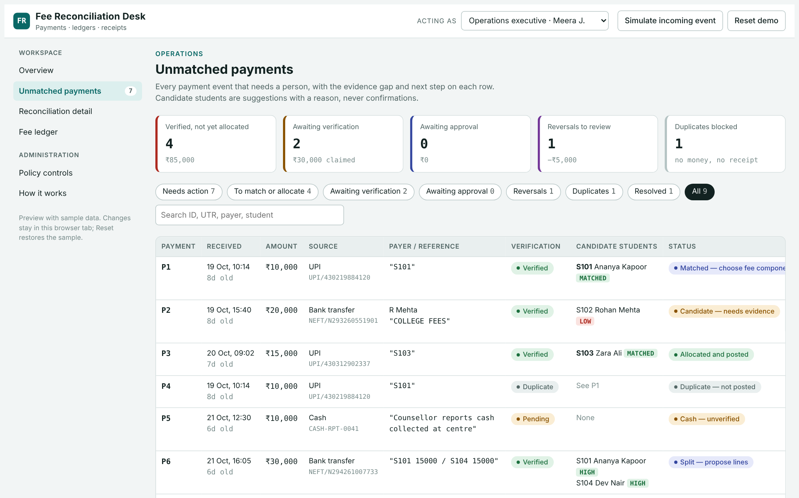
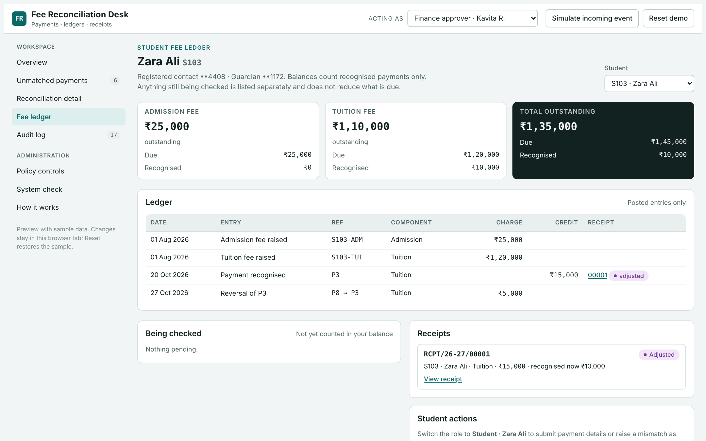
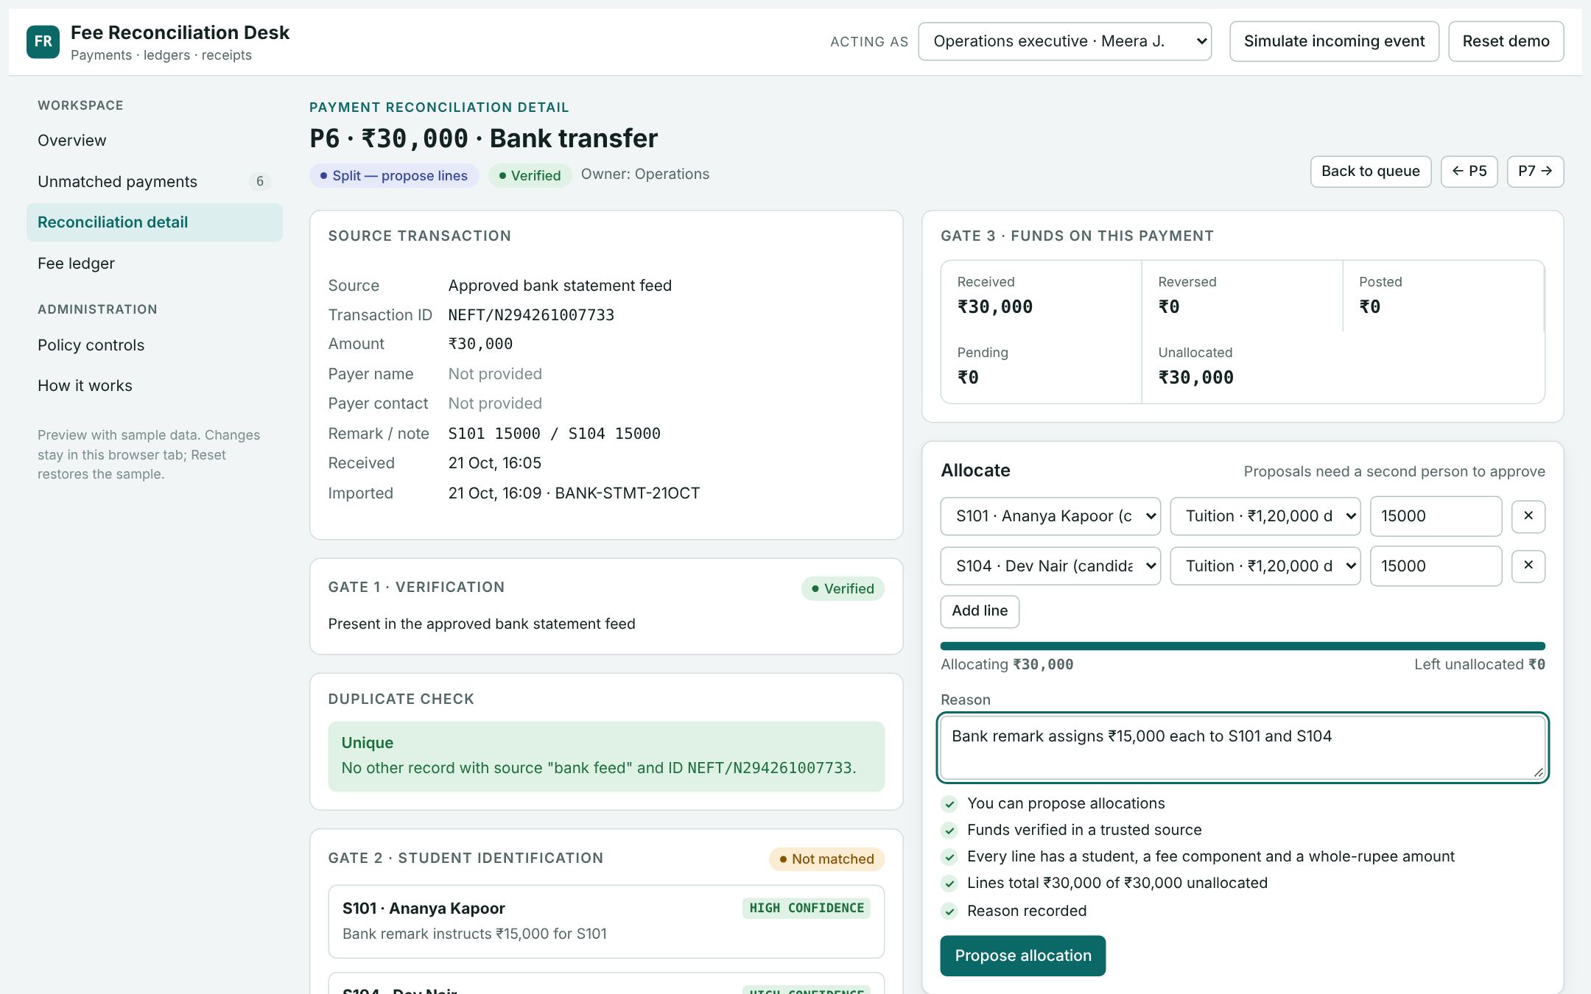
The three screens work, not just sketch
WIREFRAMES, BUILT
1 · Unmatched payments
2 · Student fee ledger
3 · Reconciliation detail
Stage tiles, evidence gap, candidates with confidence, next action, owner and age
Recognised payments only; claims shown apart as “being checked”; adjusted receipts
Evidence, gates 1–5, allocation editor with live checks, approvals, audit history
7 · Live: published preview with role switcher · installed C# app with real sign-in per role
Notes:
I built the wireframes as working screens so the panel can test the logic instead of reading about it. Screen 1 is the operations dashboard: every row shows what is missing and who owns the next step. Screen 2 is what a student sees: only recognised payments reduce the balance; their screenshot claim sits apart as under review, and the P8 reversal shows as an adjustment, not an edit. Screen 3 is where an investigator works: buttons are disabled with the reason whenever a permission, verification or amount check fails. Offer to demo live: open P6, propose the split as Operations, try to approve as the same person, then approve as Finance.

Slide 8
Separate states, minimum data, explicit permissions
DEVELOPMENT-READY PRD
State models, one per question
Minimum data entities
Verification claimed → verified · Identification unmatched → candidate → matched · Allocation proposed → approved → posted · Receipt issued → adjusted · Reversal requested → applied
Payment source record · student claim · cash report · match candidate · allocation proposal + lines · ledger entry · receipt · reversal / correction · case · audit event
Permissions, by person
Open decisions owned by Finance
Student: own data only · Counsellor: report cash · Operations: match, propose, cases · Finance: import, verify, approve others’ work, reverse · Admin: roles and policy, no money
A-01 fee-component order · A-02 cash deposit window · A-03 match evidence standard · A-04 refund vs credit for excess · A-05 single-approval threshold · A-06 receipt numbering
Integrations: bank statement feed in, student-system posting out (idempotent). Non-functional: every action audited, role-filtered data, posting retry-safe, daily reconciliation export.
8 · Full PRD with 16 acceptance criteria and the payment decision matrix submitted alongside
Notes:
The core design choice: the APM draft had one "status" field doing five jobs. I split it into one state machine per question, so "we know who paid" can never be confused with "the money is on the ledger". The entities are the minimum to answer an audit query: who decided, on what evidence, and what changed. The six open decisions are policy, not engineering; I have defaulted each to the safe option in the build (for example, no automatic fee component) so engineering is not blocked while Finance decides. Likely question: why not let Admin approve in a pinch? Answer: anyone who can change roles and also move money can grant themselves anything; keeping Admin off the money path is the cheapest control we have.

Slide 9
Five questions to settle before sprint one
ENGINEERING AND QA HANDOFF
1 · Bank feed: source, format, and is the UTR unique per bank?
Prototype evidence QA can rerun
2 · Student system: write contract and idempotency key for postings
27/27
14/14
C# self-tests
End-to-end flows
3 · Concurrency: record versioning when two reviewers act at once
0 of 19
20 → 1
4 · Ledger of record and the daily reconciliation job
Security checks open
Race: one posting
5 · Audit and evidence storage: security, retention, recovery
Release gates: 16 acceptance criteria pass · control difference ₹0 on a month of real data · Finance signs policy A-01 to A-06
Risks: feed delays leave money unverified; name-only payers stay manual; Finance approval becomes the bottleneck
9 · Prototype is evidence of the logic, not production code; engineering owns the build
Notes:
I would bring these five questions to the first engineering session rather than answer them myself; each one changes the architecture. Question 1 decides how strong our duplicate rule can be. Question 2 decides whether retries are safe end to end, not just inside our tool. The test numbers are from the working prototype: they prove the rules hold, including when 20 requests hit the same payment at once, and QA can rerun them. I would be clear that the prototype is not the production system. Likely question: what would you cut if engineering says four weeks? Answer: the student-facing claim screen and cases; the bank import, matching, approval and posting are the irreducible core.

Slide 10
Coach the APM; give the founder decisions, not detail
LEADING THE TEAM, INFORMING THE FOUNDER
To the APM
Founder update
Amber
illustrative
Did well: named the users, captured the pain, kept the scope small
Done: spec reworked; working prototype passes all tests
Fix: verify before allocating · split the status · no deletes · two people per approval · define duplicates
Risk: no policy owner means no launch date
Ask 1: name the Finance Controller as policy owner; sign-off by Friday
Send back: rewrite P2, P5, P7 and P9 with what would conclude each
Ask 2: yes or no on virtual accounts per student for phase 2
I own: the control model and Finance sign-off
10 · Phase 2: virtual account per student removes name-only matching at the source
Notes:
For the APM, I start with what is genuinely good so the corrections land, and I give the work back rather than rewriting it: they rewrite the four unresolved payments themselves, against the evidence standard. What I keep is the part that needs seniority: the control model and getting Finance to own policy. The founder update is illustrative: it is the shape I would send on a Thursday. Amber, because the build is on track but the launch depends on a decision only the founder can unblock quickly. Two asks, each answerable in a line. Virtual accounts are the strategic fix: if every student pays into a unique account number, P2 and P9 stop existing. Close by inviting questions or a live demo.

